Slide 2




Introduction to MEF
Stefan Dobrev
Stefan Dobrev
@ligaz
http://feeds.feedburner.com/ligaz
stefan.dobrev-at-telerik.com
stefan.dobrev-at-gmail.com

Slide 3
What is MEF?
Just a library. A dll. An assembly.
Provides common abstraction for building composite applications
Enable 3rd parties to extend an existing application
Source code is open at mef.codeplex.com

Slide 4
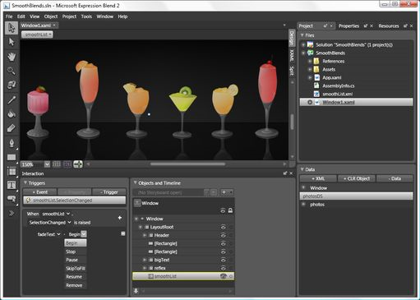
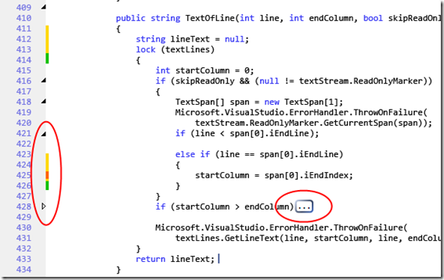
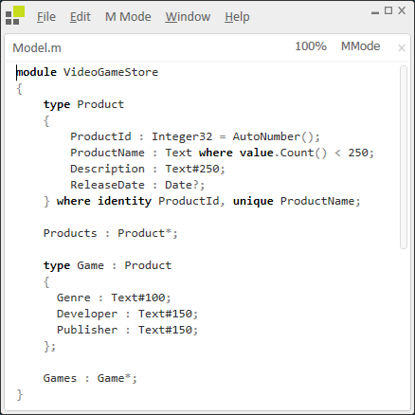
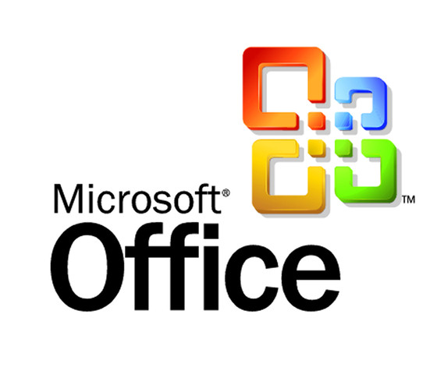

Why building MEF?

Slide 5
Why MEF matters?
Simplifies the creation of extensible applications.
Provides a standard way for the host application to expose itself and consume external extensions.
Decoupling components via IoC
Part of .NET Framework

Slide 6
Main actors
Build around consumer-producer pattern
Part – can consume and produce (import/export)
Catalog – a set of parts
Container – the magic box

Slide 7
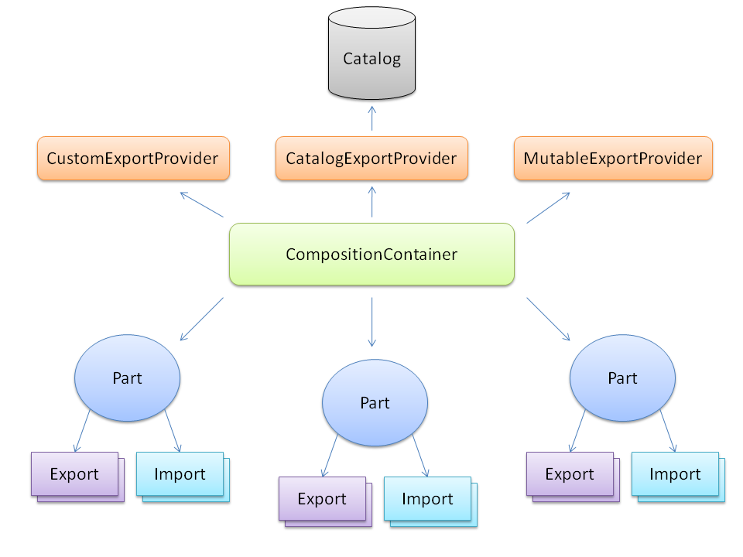

Slide 8
[Export]
Property exports
Method Exports
Export metadata
through [ExportMetadata]
with custom attributes
Lazy Exports
Works on non public parts (not in partial/medium trust)

Slide 9
[Import]
Property Imports
Field Imports
Importing collections / arrays with [ImportMany]
Recomposable imports - IPartImportsSatisfiedNotification

Slide 10
Catalogs
Type Catalog
Assembly Catalog
Directory Catalog
Aggregating Catalog – combines multiple catalogs into a single catalog

Slide 11
Demo

Slide 12
Advanced MEF topics
A general purpose abstraction for composition using parts and definitions
MEF programming models
Attributed programming model
Functional programming model
Provider based programming model
Support for dynamic languages

Slide 13
Q&A
?

